Slide 1
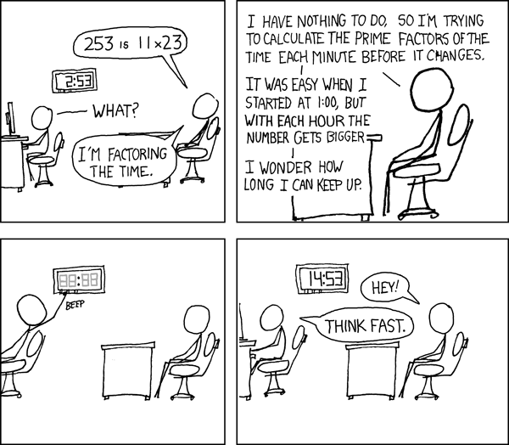
Divisibility in Rings
Petr Samodelkin
Elias Köhnlein

Slide 2
The Definitions

Slide 3
Definition 1. Divides:
Mathematical Expression
Lean Code
We define x | y if ∃a, y = a · x
def Divides (x y : R) : Prop :=
∃ a, y = a * x
notation x " | " y => Divides x y

Slide 4



Definition 2. Unit:
Mathematical Expression
Lean Code
We say a is a unit, if it has an multiplicative inverse:
Example:
In Z₁₀: 2, 4 and 5 aren’t units, but 1, 3, 7, 9 are.
In-Built:
a is a unit, if there’s an element of which equals a.
Elements of have double-sided inverses by definition.
Notes:
R^x is the unit group of R,

Slide 5
Definition 2. IsAssociated:
Mathematical Expression
Lean Code
x and y are associated if there exists a unit a, such that:
y = a · x
In Z_{10,} 2, 4, 6, 8 are associated:
2 * 3 ≡ 6 , 6 * 7 ≡ 2.
2 * 7 ≡ 4 , 4 * 3 ≡ 2
def IsAssociated (x y : R): Prop :=
∃ (a : R), y = a * x
lemma isAssociated_is_symmetric
lemma isAssociated_is_transitive
Notes:
Being associated is an equivalence relation, easy to see if you multiply both sides by the inverse of a.

Slide 6
Definition 3. IsNontrivial:
Mathematical Expression
Lean Code
x is nontrivial if x ≠ 0 and ¬(IsUnit x)
def IsNontrivial (x : R) Prop := x ≠ 0 ∧
¬(IsUnit x)

Slide 7
Definition 4. IsIrreducible:
Mathematical Expression
Lean Code
x is irreducible, if:
x is nontrivial
For any a, b in R, such that a*b=x, one of them is a unit.
=>it cannot be factored in 2 non-unit elements.
def IsIrreducible (x : R) : Prop :=
IsNontrivial x ∧ ∀ a b,
x = a * b →
IsUnit a ∨ IsUnit b
Notes:
That’s the same as usual definition of primes in N.

Slide 8
Definition 5. IsPrime:
Mathematical Expression
Lean Code
x is prime if
x is nontrivial, and
Euclid’s lemma applies:
If x divides ab, it divides either a or b.
def IsPrime (x : R) : Prop :=
IsNontrivial x ∧ ∀ a b, (x | a * b) → (x | a) ∨ (x | b)
Notes:
For example in N,
5 | (15 * 3) = 45 → 5 | 15

Slide 9
The two Theorems

Slide 10
Theorem 1. Every Prime Element is Irreducible in an Integral Domain
Formal Statement:
Let R be an integral domain and x ∈ R.
If x is prime, then x is irreducible.

Slide 11
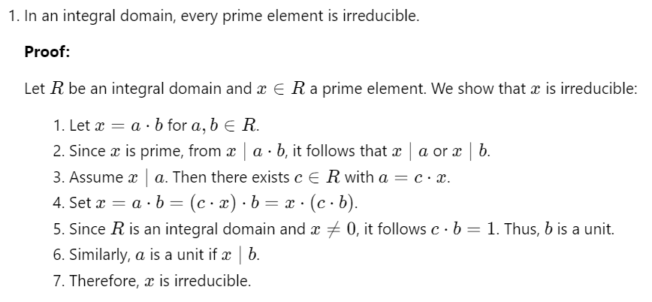
Theorem 1: LaTeX proof

Slide 12
Theorem 1: Lean 4 code
theorem isIrreducible_of_isPrime [IsDomain R] (x : R) (h : IsPrime x) : IsIrreducible x := by
obtain ⟨hnontrivial, hdiv⟩ := h – x nontrivial and x|a*b
constructor
· exact hnontrivial
· intros a b h_mul
-- x divides a * b, as x = a * b
have hx_divides_ab : x | a*b := by
use 1; simp[h_mul]
have hxa_or_xb := hdiv a b hx_divides_ab -- x divides either a or b because it's prime
rcases hxa_or_xb with hxa | hxb -- if x | a, substitute a = c * x, to get x = x * (c * b)
· exact Or.inr (is_unit_of_mul_eq_one h_mul hnontrivial hxa)
· have h_mul1 : x = b * a := by -- same here
simp[mul_comm, h_mul]
exact Or.inl (is_unit_of_mul_eq_one h_mul1 hnontrivial hxb)

Slide 13
Theorem 1: Lean 4 code
lemma is_unit_of_mul_eq_one [IsDomain R] {a b x: R} (h_mul : x = a * b) (hnontrivial: IsNontrivial x) (hxa: Divides x a) : IsUnit b := by
-- we have x|a, x=ab, x ≠ 0
obtain ⟨c, hxa⟩ := hxa -- a = c * x
rw [hxa, mul_comm, ←mul_assoc] at h_mul -- rewrite to a * b = x = b * c * x
have hbc1 : b * c = 1 := by –- x * y = x and x ≠ 0 => y = 1
apply (mul_eq_right₀ hnontrivial.left).mp
rw[←h_mul]
exact isUnit_of_mul_eq_one b c hbc1 -- in-built lemma: b * c = 1 → b is unit
Notes:
In einem Integritätsbereich gibt es eine spezielle Eigenschaft, dass, wenn das Produkt von zwei Elementen b und c gleich 1 ist (b * c = 1), dann sind b und c Einheiten (d.h., sie haben Inversen).Der Code beweist dies wie folgt:
Zuerst wird a = c * x durch hxa festgestellt.
Dann wird die Gleichung x = a * b umgeschrieben in a * b = x und durch Kommutativität und Assoziativität umgeformt, um x = b * c * x zu erhalten.
Anschließend wird gezeigt, dass b * c = 1 gilt, was durch die Tatsache erreicht wird, dass das Produkt von b und c gleich 1 ist.
Schließlich wird auf ein vorhandenes Lemma zurückgegriffen, um zu beweisen, dass b eine Einheit ist, da b * c = 1 impliziert, dass b eine Einheit ist.

Slide 14
Definition 6. Unique factorization domain
Mathematical expression
Lean code:
A ring D is UFD if:
It’s an integral domain
Every non-zero, non- unit element is factorable into irreducibles
such factorization is unique up to associates and permutation
Wait for it…

Slide 15
Definition 6. IsFactorialRing: Lean
def IsUFD (D: Type) [CommRing D] [IsDomain D]: Prop :=
-- It's based on an integral domain D
-- every non-trivial element is factorable into irreducibles
(∀ (x : D), x ≠ 0 → ¬IsUnit x → ∃ (factors :List D), -- for any non-zero, non-unit x in D there's a list
((∀ y ∈ factors, IsIrreducible y) ∧ x=List.prod factors)) ∧ -- of irreducibles that multiply to x
-- And such factorisation is unique up to associates and permutation:
(
∀ (x : D) (factors1 factors2 : List D), -- for any x in D, if there exist 2 lists
x ≠ 0 → (¬IsUnit x) → -- such that x is non-zero and non-unit
(x = List.prod factors1) → (x = List.prod factors2) → -- that x is the product of the factors in each list
(∀ y ∈ factors1, IsIrreducible y) → (∀ y ∈ factors2, IsIrreducible y) → -- and those lists are made up of irreducibles
((factors1.length=factors2.length) ∧ -- then they are of equal length
∃ σ ∈ factors1.permutations, -- and there exists a permutation of one of them, here called sigma
(∀ i : Fin σ.length, (IsAssociated (σ.get i) (factors2.get! i )))) -- such that sigma[i] is associated to factors2[i]
)

Slide 16
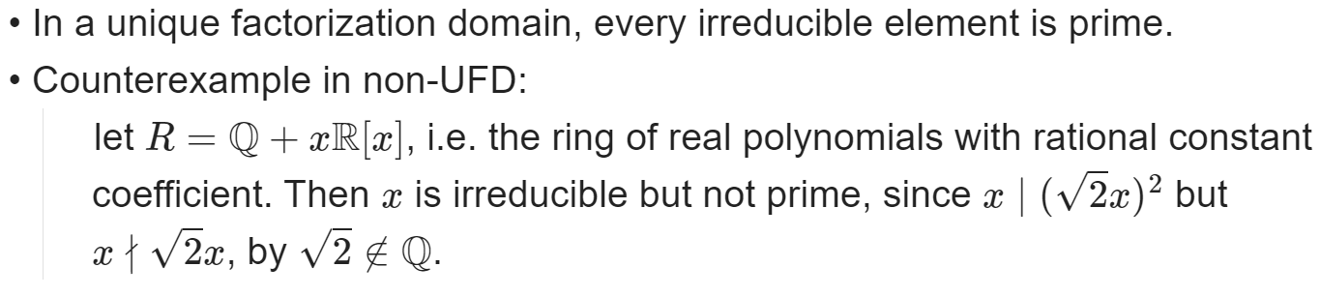
Theorem 2 : Statement

Slide 17
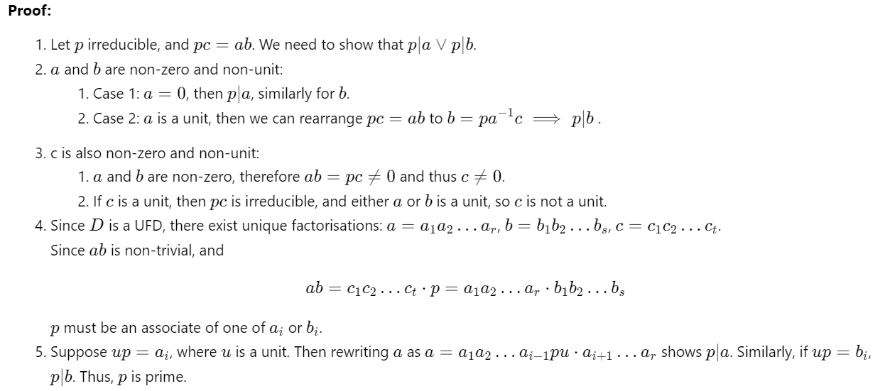
Theorem 2: LaTeX Proof

Slide 18
Thank you for your attention!

